Slide 1
CMPT 238 Data structures & Algorithms
Hash Tables
(CLRS Chapter 11)

Slide 2
Outlines
Direct‐address tables
Hash tables
Hash functions
Open addressing

Slide 3
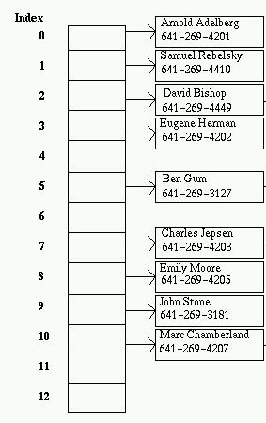
Direct‐address tables
Hash tables are a common approach to the storing/searching problem.
Scenario:
Each element has a key drawn from a universe U = {0, 1,…, m-1}, where m isn’t too large.
No two elements have the same key.

Slide 4
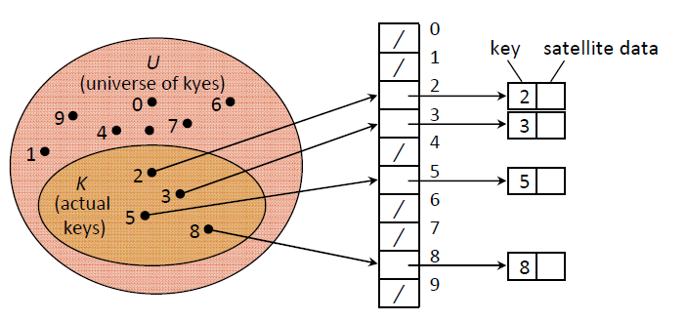
Direct‐address tables
A direct‐address table is an array, T [0..m-1]:
Each slot, or position, corresponds to a key in U.
Given a key k, we find the element by just looking in the kth position of the array. This is called direct addressing.

Slide 5
DIRECT‐ADDRESS‐SEARCH(T, k)
return T[k]
DIRECT‐ADDRESS‐INSERT(T, x)
T[x.key] ← x
DIRECT‐ADDRESS‐DELETE(T, x)
T[x.key] ← NIL
Running time?
Dictionary operations are trivial and take O(1) time each.

Slide 6
Direct‐address Tables
Problem:
If the universe U is large, storing a table of size |U| may be impractical or impossible.
The set K of keys actually stored is small, compared to U, so that most of the space allocated for T is wasted.

Slide 7
Hash tables
Solution: Hash tables
When K is much smaller than U, a hash table requires much less space than a direct‐address table.
Storage requirements can be reduced to O(|K|).
Searching for an element requires O(1) time, but in the average case, not the worst case.

Slide 8
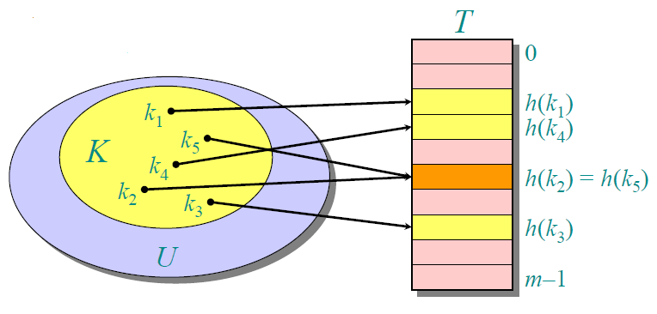
Hash tables
Idea: Instead of storing an element with key k in slot k, use a function h and store the element in slot h(k).
We call h a hash function: U → {0, 1, . . . , m − 1}
We say that k hashes to slot h(k).
We also say that h(k) is the hash value of key k.

Slide 9
Collisions
Collisions: When two or more keys hash to the same slot.
Methods to resolve the collision problem.
Chaining
Open addressing

Slide 10
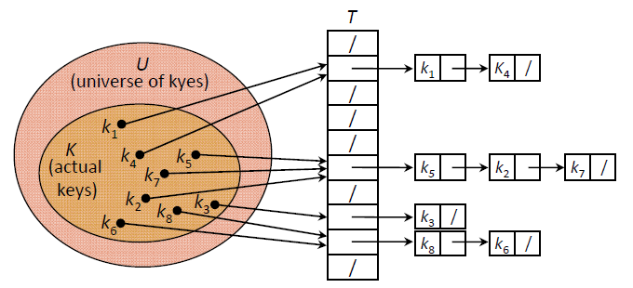
Collision resolution by chaining
Put all elements that hash to the same slot into a linked list.
Slot j contains a pointer to the head of the list of all stored elements that hash to j.
If there are no such elements, slot j contains NIL.

Slide 11
Dictionary operations with chaining
CHAINED‐HASH‐INSERT(T,x):
Insert x at the head of list T[h(x.key)]
Worst‐case running time is O(1).

Slide 12
Dictionary operations with chaining
CHAINED‐HASH‐SEARCH(T,k):
Search for an element with key k in list T[h(k)]
Running time is proportional to the length of the list of elements in slot h(k).

Slide 13
Dictionary operations with chaining
CHAINED‐HASH‐DELETE(T,x):
Delete x from the list T[h(x.key)]
Running time is proportional to the length of the list of elements in slot h(k). Or O(1) HOW???

Slide 14
Analysis of hashing with chaining
How long does search take?
Worst case
when all n keys hash to the same slot
O(n)
Average case
depends on how well the hash function distributes the keys among the slots.
load factor α = n / m, m hash domain, n keys domain.
O(1 + α) assuming simple uniform hashing, or
O(1), If the number of hash-table slots is at least proportional to the number of elements in the table.

Slide 15
What makes a good hash function?
Ideally, the hash function satisfies the assumption of simple uniform hashing.
Each key is equally likely to hash to any of the m slots
How to compute hash functions?
Multiplication method
Division method

Slide 16
What makes a good hash function?

Slide 17
Interpreting keys as natural numbers
Most hash functions assume that the universe of keys are natural numbers (0, 1, 2, …).
If the keys are not natural numbers, we find a way to interpret them as natural numbers.
Example: Interpret a character string as an integer expressed in some radix notation.
Suppose the string is CLRS.

Slide 18
Interpreting keys as natural numbers
Suppose the string is CLRS.
ASCII values: C = 67, L = 76, R = 82, S = 83.
There are 128 basic ASCII values.
So interpret CLRS as (67 ∙ 128³) + (76 ∙ 128²) + (82 ∙ 128¹) + (83 ∙ 128⁰) = 141,764,947.
Or interpret CLRS as 67 + 76 + 82 + 83 = 308
But SRLC = 83 + 82 + 76 + 67 = 308!!!

Slide 19
The division method
Method: h(k) = k mod m.
Example: m = 20 and k = 91, => h(k) = 11.
Advantage: Fast, since requires just one division operation.
Disadvantage: Have to avoid certain values of m:
Powers of 2 are bad. If m = 2^{p} for integer p, then h(k) is just the least significant p bits of k, => more collisions.
Good choice:
A prime not too close to an exact power of 2. ex 23

Slide 20
The multiplication method
Method:
Choose constant A in the range 0 < A < 1.
Multiply key k by A.
Extract the fractional part of kA.
Multiply the fractional part by m.
Take the floor of the result.
h(k) = m(kA – kA)
Disadvantage : Slower than division method.
Advantage: Value of m is not critical.
We typically choose m to be a power of 2 (m = 2^{p} for some integer p)

Slide 21
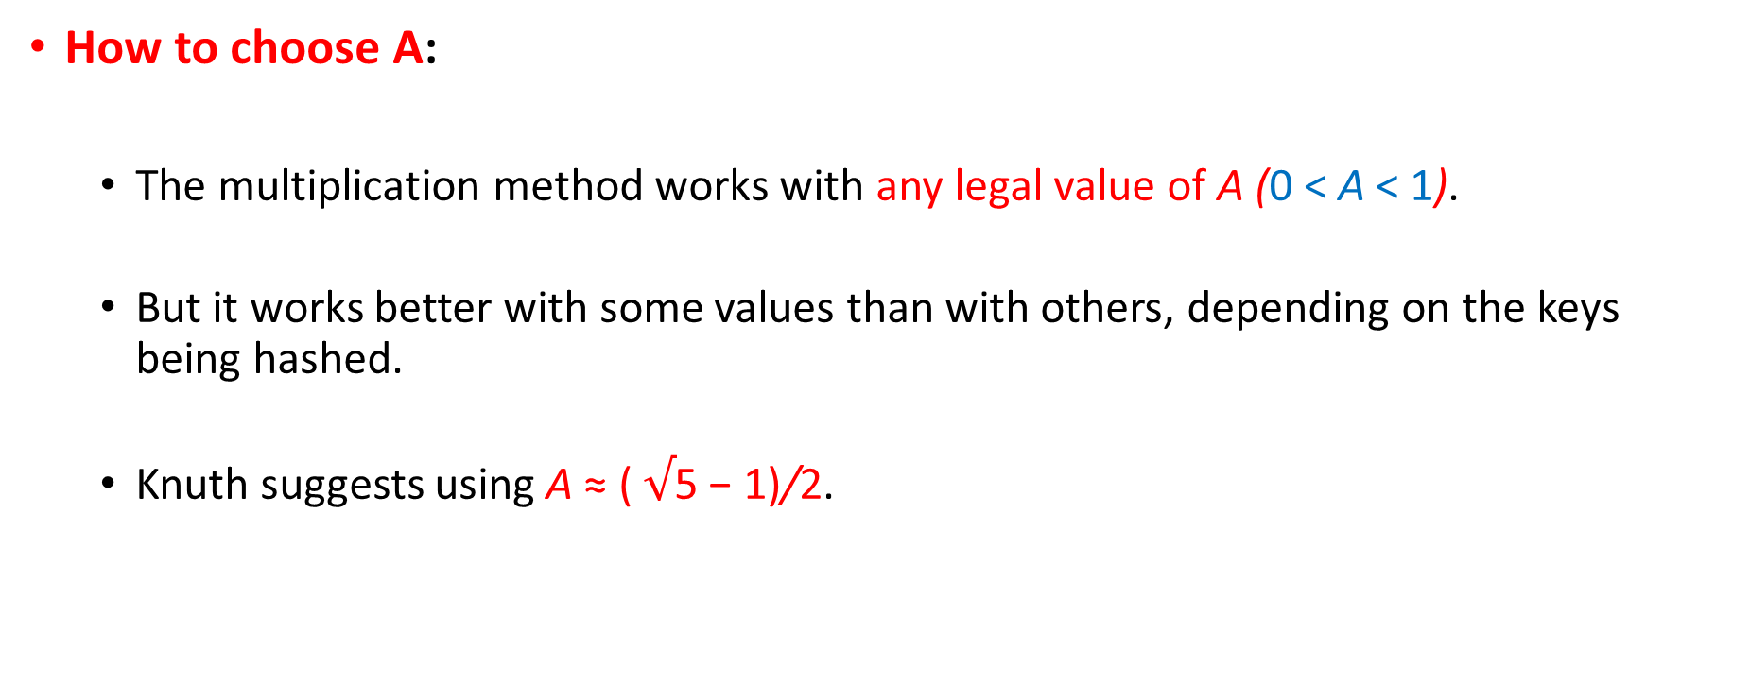
The multiplication method
How to choose A:
The multiplication method works with any legal value of A (0 < A < 1).
But it works better with some values than with others, depending on the keys being hashed.
Knuth suggests using A ≈ ( $√$5 − 1)/2.

Slide 22
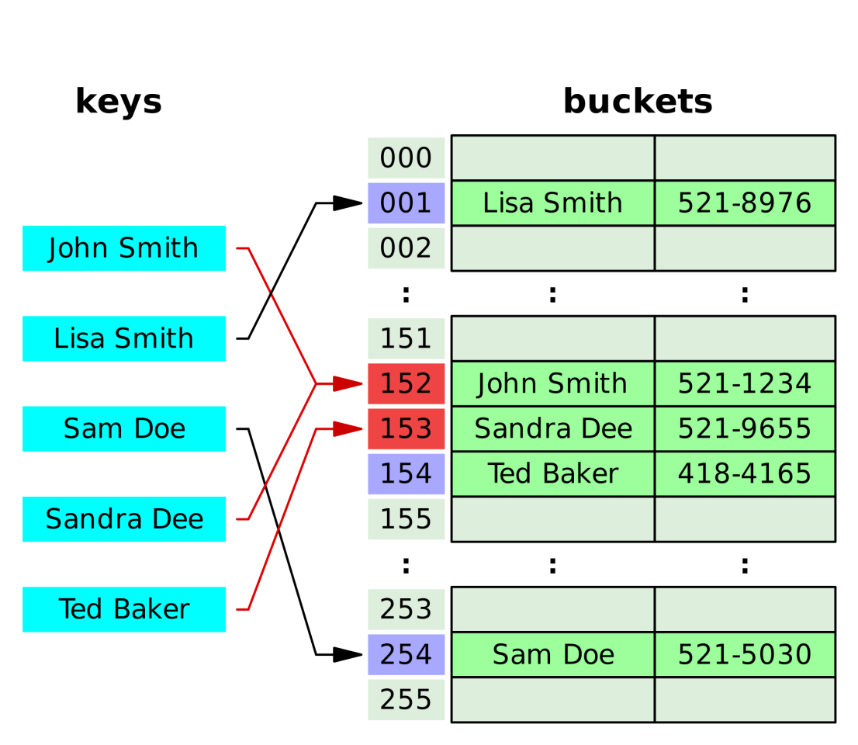
Open addressing
An alternative to chaining for handling collisions.
Idea: Store all elements in the hash table itself.
Advantage:
Avoid pointers.
Has a larger number of slots for the same amount of memory.
Disadvantage:
The table can “fill up”

Slide 23
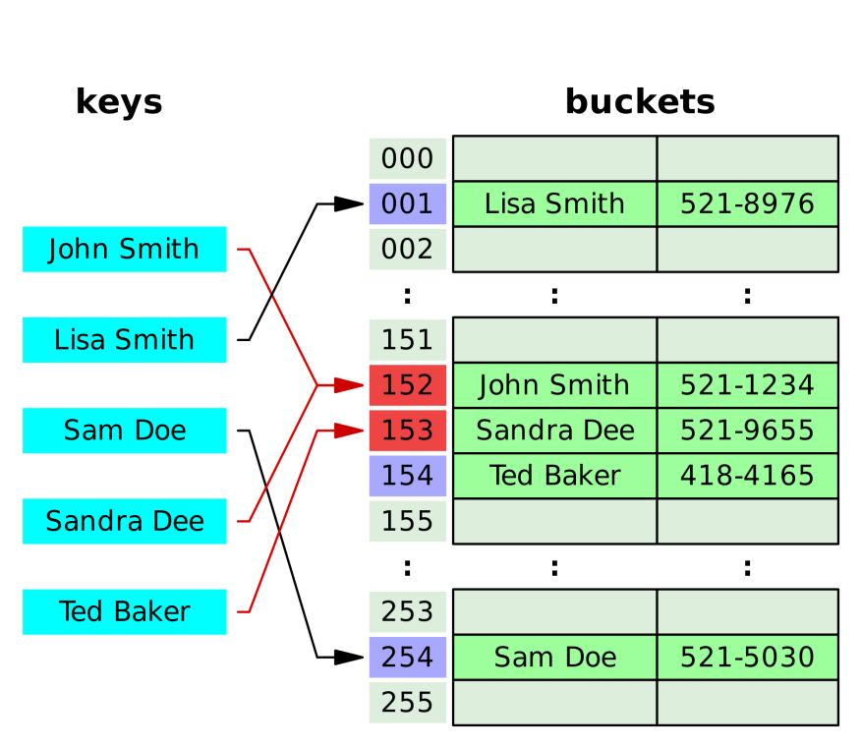
Insertion
We successively examine, or probe, the hash table until we find an empty slot.
The sequence of positions probed depends upon the key being inserted.
The probe sequence is h(k,0), h(k, 1),…, h(k,m−1).

Slide 24
Insertion
HASH‐INSERT(T, k)
1. i ← 0
2. repeat j ← h(k, i)
3. if T[j] = NIL
4. T[j] ← k
5. return j
6. else i ← i + 1
7. until i = m

Slide 25
Searching
HASH‐SEARCH(T, k)
1. i ← 0
2. repeat j ← h(k,i)
3. if T[j] = k
4. return j
5. i ← i + 1
6. until T[j] = NIL or i = m
7. return NIL

Slide 26
Deletion
Can we simply mark the slot as empty by storing NIL in it?
Solution: Use a special value DELETED instead of NIL when marking a slot as empty during deletion.
What happens to search and insertion?
Search should treat DELETED as though the slot holds a key that does not match the one being searched for.
Insertion should treat DELETED as though the slot were empty, so that it can be reused.

Slide 27
Three probing methods
Three commonly used techniques to compute the probe sequences:
Linear probing
Quadratic probing
Double hashing
Gives the best results

Slide 28
Linear probing
Given an ordinary hash function h‘, which we refer to as an auxiliary hash function, the method of linear probing uses the hash function
h(k, i) = (h'(k) + i) mod m
for i = 0, 1, ..., m − 1.
Linear probing suffers from primary clustering: long runs of occupied sequences build up.
Increasing the average search and insert time.

Slide 29
Linear Probing Example
insert(14)
14%7 = 0
insert(8)
8%7 = 1
insert(21)
21%7 =0
insert(2)
2%7 = 2
h’(k) =k
h(k) = (h’(k)+i) mod m
0
14
0
14
0
14
0
14
1
1
8
1
8
1
8
2
2
2
21
2
21
3
3
3
3
2
4
4
4
4
5
5
5
5
6
6
6
6
probes:
1
1
3
2
Notes:
You can see that this works pretty well for an empty table and gets worse as the table fills up.
There’s another problem here. If a bunch of elements hash to the same spot, they mess each other up.
But, worse, if a bunch of elements hash to the same area of the table, they mess each other up! (Even though the hash function isn’t producing lots of collisions!)
This phenomenon is called primary clustering.

Slide 30
Quadratic probing
Quadratic probing uses a hash function of the form
h(k, i) = (h’(k) + c₁i + c₂i²) mod m
where h' is an auxiliary hash function, c1 and c2 != 0 are auxiliary constants, and i = 0, 1, ..., m−1.
Main Idea: Spread out the search for an empty slot.
If two keys have the same initial probe position, then their probe sequences are the same. This property leads secondary clustering.

Slide 31
Quadratic Probing Example
insert(14)
14%7 = 0
insert(8)
8%7 = 1
insert(1)
1%7 =1
insert(22)
22%7 = 1
h’(k) =k
h(k) = (h’(k)+ i + i²) mod m
c1 = c2 = 1
0
14
0
14
0
14
0
14
1
1
8
1
8
1
8
2
2
2
2
3
3
3
1
3
1
4
4
4
4
5
5
5
5
6
6
6
6
21
probes:
1
1
2
4
Notes:
You can see that this works pretty well for an empty table and gets worse as the table fills up.
There’s another problem here. If a bunch of elements hash to the same spot, they mess each other up.
But, worse, if a bunch of elements hash to the same area of the table, they mess each other up! (Even though the hash function isn’t producing lots of collisions!)
This phenomenon is called primary clustering.

Slide 32
Double Hashing
Double hashing uses a hash function of the form
h(k, i) = (h₁(k) + ih₂(k)) mod m
where h1 and h2 are auxiliary hash functions.

Slide 33
An example for double Hashing
h(k, i) = (h₁(k) + ih₂(k)) mod m
Hash table size: m = 13.
h₁(k) = k mod 13;
h₂(k) = 1 + (k mod 11)
Where should we insert 14?
The sequence of hashed values is 79, 69, 72, 98, 50, 14
 | 79 |  |  | 69 | 98 |  | 72 |  |  |  | 50
0 | 1 | 2 | 3 | 4 | 5 | 6 | 7 | 8 | 9 | 10 | 11 | 12

Slide 34
Double Hashing Example
insert(14)
14%7 = 0
insert(8)
8%7 = 1
insert(21)
21%7 =0
5-(21%5)=4
insert(2)
2%7 = 2
insert(1)
1%7 = 1
5-(1%5)=4
h₁(k) =k mod m
h₂(k) = (R – (K mod R))
h(k) = (h₁(k) + ih₂(k)) mod m
R = 5, m = 7
0
14
0
14
0
14
0
14
0
14
1
1
8
1
8
1
8
1
8
2
2
2
2
2
2
2
3
3
3
3
3
4
4
4
21
4
21
4
21
5
5
5
5
5
6
6
6
6
6
probes:
1
1
2
1
??
Notes:
You can see that this works pretty well for an empty table and gets worse as the table fills up.
There’s another problem here. If a bunch of elements hash to the same spot, they mess each other up.
But, worse, if a bunch of elements hash to the same area of the table, they mess each other up! (Even though the hash function isn’t producing lots of collisions!)
This phenomenon is called primary clustering.

Slide 35
Double Hashing Example
insert(14)
14%7 = 0
insert(8)
8%7 = 1
insert(21)
21%7 =0
5-(21%5)=4
insert(2)
2%7 = 2
insert(1)
1%7 = 1
5-(1%5)=4
0
14
0
14
0
14
0
14
0
14
1
1
8
1
8
1
8
1
8
2
2
2
2
2
2
2
3
3
3
3
3
4
4
4
21
4
21
4
21
5
5
5
5
5
7
6
6
6
6
6
probes:
1
1
2
1
4
Notes:
You can see that this works pretty well for an empty table and gets worse as the table fills up.
There’s another problem here. If a bunch of elements hash to the same spot, they mess each other up.
But, worse, if a bunch of elements hash to the same area of the table, they mess each other up! (Even though the hash function isn’t producing lots of collisions!)
This phenomenon is called primary clustering.

Slide 36
Double Hashing
h(k, i) = (h₁(k) + ih₂(k)) mod m
The value h₂(k) must be relatively prime to the hash‐table size m (their greatest common divisor is one) for the entire hash table to be searched.
Option 1: Let m be a power of 2 and to design h₂ so that it always produces an odd number.
Option 2: Let m be prime and have 1 < h₂(k) < m.

